Slide 1
ALABAMA Minor Consent and Confidentiality Laws
For educational purposes only
Notes:
Today we are going to do a 15-minute mini-training, also called a Spark. As youth-serving professionals, it is important that we understand adolescent confidentiality and minor consent. This training is intended to be an overview of the most relevant laws on confidential services for teens.
Each person here will have times where we need to know and comply with consent and confidentiality laws, though it’s different for our various roles. For each law and scenario we discuss, try to think about how it applies to your role. To get us started, let’s review a case scenario.

Slide 2
CASE SCENARIO: SHAY, 15 Y/O GIRL
Purpose of visit Sore throat
Issue that emerges from clinician interview Concerned about having an STI
Parent information Shay says she is worried her mother will kick her out of the house if she knows Shay is sexually active
How does the right to confidentiality
help or hurt Shay?
Notes:
This is Shay, who is 15. She is here today because of a sore throat. During her visit the clinician found out that she is concerned about having an STI. Shay says she is worried her mother will kick her out of the house if she knows Shay is sexually active. How does the right to confidentiality help or hurt Shay?
[Give participants a moment to respond to the question on the slide. You may choose to have discussion here or just have people think about it.]
Usually, not all of this patient information is available to everyone who comes into contact with her. When we know more details about a patient, does it affect how we feel about the patient’s right to confidentiality? Even though we know the law says we need to provide certain confidential services to teens without a parent’s permission, it can be challenging when we think parents should be involved. What can go wrong if we accidentally break confidentiality?
[Have a couple of people respond briefly. Main point: If we don’t follow the laws, it can have a negative impact on teens.]
Many teens choose to include their parent or guardian in decisions about their health. For some teens, however, having the option of certain confidential services makes it more likely that they will seek care when they need it. For instance, Shay would probably be more likely to get tested for STIs and possibly get a method of contraception if she’s assured her mother’s permission is not required.

Slide 3
IMPORTANT DEFINITIONS
consent
Permission to act
Parent/guardian must give consent before their minor child can receive services (except specific confidential services)
confidentiality
How providers and staff keep certain information confidential
Consent ≠ Confidentiality
Notes:
Before we review the laws, it’s important to recognize the difference between consent and confidentiality.
Consent is permission to act. In general, a parent or legal guardian must give their permission – or “consent” – before their minor child can receive a medical service. However, there are important exceptions where a minor can consent to their own care, without a parent’s permission. We will discuss these exceptions today.
Confidentiality refers to how health care providers and staff keep certain information private.
Consent does not equal confidentiality.
o Even if a minor is allowed to consent to a service without a parent’s permission, it does not necessarily mean that the provider is required to keep it confidential.
o So, laws can protect a minor’s right to access a specific service, like contraception, but often, it’s up to health care providers and staff to protect a minor’s confidentiality.

Slide 4
Al Law: Parental consent exceptions
A parent or legal guardian must provide consent on behalf of a minor under the age of 14 before health care services are provided, with several important exceptions.
The exceptions are based on either:
Status, or
The type of service requested (such as certain sexual health services)
Notes:
As this slide says, a parent or legal guardian must provide consent on behalf of a minor (under age 14) before health care services are provided, with several important exceptions.
The exceptions are based on either:
- Status (for example, legal independence from parents/guardians), or
- The type of service requested (such as certain sexual health services).
Pass out the “Alabama Minor Consent & Confidentiality Laws” handout.

Slide 5
Al law: minor consent based on status
The minor is 14 years of age or older -OR-
The minor is under the age of 14 and at least one of the following applies:
They have graduated from school
They are married or divorced
They are pregnant
They are a parent
Notes:
Here’s a handout that explains Alabama’s minor consent and confidentiality laws . As we see in the top section, Alabama’s law allows certain minors to consent to services based on their status. This includes:
-Minors 14 years of age or older
-Minors under the age of 14 who have graduated from school
-Minors under the age of 14 who are married or divorced
-Minors under the age of 14 who are pregnant
-Minors under the age of 14 and a parent

Slide 6
AL LAW: minor consent based on service
Minors may receive the following care without parental/guardian consent:
Non-prescription contraceptives such as condoms or over-the-counter emergency contraception.
Testing and treatment for sexually transmitted infections (STIs) including HIV.
Pregnancy and prenatal care (this does not include abortion).
Medical care for their children.
5. Counseling and treatment for substance abuse.
6. Counseling and treatment for mental health.
NOTE: Only minors 14 years or older may receive Pre-exposure Prophylaxis (PrEP) without parental consent.
Notes:
Now let’s look at the services any minors can receive without parental or guardian consent:
Non-prescription contraceptives such as condoms or over-the-counter emergency contraception.
Testing and treatment for sexually transmitted infections (STIs) including HIV.
Pregnancy and prenatal care (this does not include abortion).
Medical care for their children.
5. Counseling and treatment for substance abuse.
6. Counseling and treatment for mental health.
Note that only minors aged 14 and older can consent to PrEP

Slide 7
AL Law: The 21st century cures act
The 21st Century Cures Act requires health care providers to make all electronically maintained health information, except for psychotherapy notes, easily accessible to patients in a reasonable time frame.
Notes:
Now, we will talk about the Cures Act. The Cures Act requires health care providers to make all health information, except for psychotherapy notes, easily accessible to patients in a reasonable time frame.

Slide 8
AL Law: The 21st century cures act
RECOMMENDATIONS FROM THE AMERICAN ACADEMY OF Pediatrics
Offer access to as much health information as possible through apps, portals, or other HIPAA compliant avenues, without requiring additional action or fees from the patient.
Implement an identity verification process when health information is available through a portal or app to reduce the likelihood of someone other than the minor accessing the application.
Ensure that access to health information for minors is separate from their parent’s.
Notes:
Here are some recommendations from the American Academy of Pediatrics regarding the Cures Act. They recommend that health care providers offer access to as much health information as possible through apps, portals, or other HIPAA compliant avenues, without requiring additional action or fees from the patient. In order to reduce the likelihood of someone other than the minor accessing the application, they recommend that an identity verification process is implemented and that a minor’s access to their health information is separate from their parent’s access to their medical records.

Slide 9
AL Law: The 21st century cures act
RECOMMENDATIONS FROM THE AMERICAN ACADEMY OF Pediatrics:
Establish procedures for health information requests from different parties.
Create protocols for what health information will not be shared with patients or parents, even if it is requested, based on state and federal law.
Notes:
Some more recommendations from the AAP include establishing procedures for health information requests from different parties (such as parents and guardians) and creating protocols for what health information will not be shared with patients or parents, even if it is requested, based on state and federal law.

Slide 10
AL Law: The 21st century cures act
Exceptions to parental access to a minor’s health information:
When a parent’s consent for health care was not required for the minor to access services.
If the minor may be at risk of physical harm by their parent due to the contents of their health record.
If it is not possible separate information protected by confidentiality laws.
Notes:
Parents are allowed to have access to a minor’s medical record with some exceptions. Listed here are some situations when providers can withhold access.
If the minor did not need their parent’s consent to receive a health care service. If the provider suspects that the minor may be at risk of physical harm by their parent. And if it is not possible to separate information protected by confidentiality laws from other information.

Slide 11
reporting
There is suspicion of abuse or neglect by an adult
The minor is at risk to themselves or someone else
There is suspicion of sexual abuse and/or exploitation
The minor is under 16 and has been sexually active with individual over the age of 18 (or over the age of 16 if the minor is at least two years younger)
Notes:
Now we’re going to review when a minor’s confidentiality must be overridden. Health care providers must override the minor’s confidentiality and report…
There is suspicion of abuse or neglect by an adult
The minor is at risk to themselves or someone else
There is suspicion of sexual abuse and/or exploitation
The minor is under 16 and has been sexually active with individual over the age of 18 (or over the age of 16 if the minor is at least two years younger)

Slide 12
CASE SCENARIO: SHAY, 15 Y/O GIRL
Purpose of visit Sore throat
Issue that emerges from clinician interview Concerned about having an STI
Parent information Shay says she is worried her mother will kick her out of the house if she knows Shay is sexually active
Can Shay receive STI testing without her parent’s permission?
Can Shay receive STI treatment without her parent’s permission?
Can Shay receive contraception without her parent’s permission?
Notes:
Let’s go back to our 15-year-old patient, Shay , and answer these questions together as I read through them.
Can Shay receive STI testing without her parent’s permission? [Answer: Yes, she can]
Can she receive STI treatment without her parent’s permission? [Answer: Yes, Alabama law allows minors to receive STI testing and treatment.]
Can Shay receive contraception without her parent’s permission: [Answer: Yes, Alabama Laws allows minors to receive treatment or advice about contraceptives. Check out the Alabama Minor Consent & Confidentiality Laws handout for more specific information.]

Slide 13
CASE SCENARIO: SHAY, 15 Y/O GIRL
Information regarding consultation, examination, or treatment for a STI provided to a minor may NOT be disclosed to a parent without the teen’s consent.
If Shay’s mother calls the clinic to ask if Shay received an STI test, can this information be disclosed?
Are there other ways that Shay’s mother could find out that Shay received this service?
Notes:
If Shay’s mother calls the clinic to ask if Shay received an STI test, can this information be disclosed? [Answer: No. When a minor is consenting to confidential services, as noted prior, HIPAA is applied and information cannot be disclosed to anyone unless the minor consents.]
Are there other ways that Shay’s mother could find out that Shay received this service? [Answer: Yes, if she uses her parent’s health insurance, an explanation of benefits (EOB) form is typically sent for each visit including medical services rendered. Additionally, with office copays and/or paying out of pocket, breaches in confidentiality are possible.
For maximum confidentiality, a minor may go to a provider that is able to provide services without billing insurance or using alternative coding for confidential services. The Spark on Confidentiality Best Practices covers more strategies to ensure confidential services for minors.

Slide 14
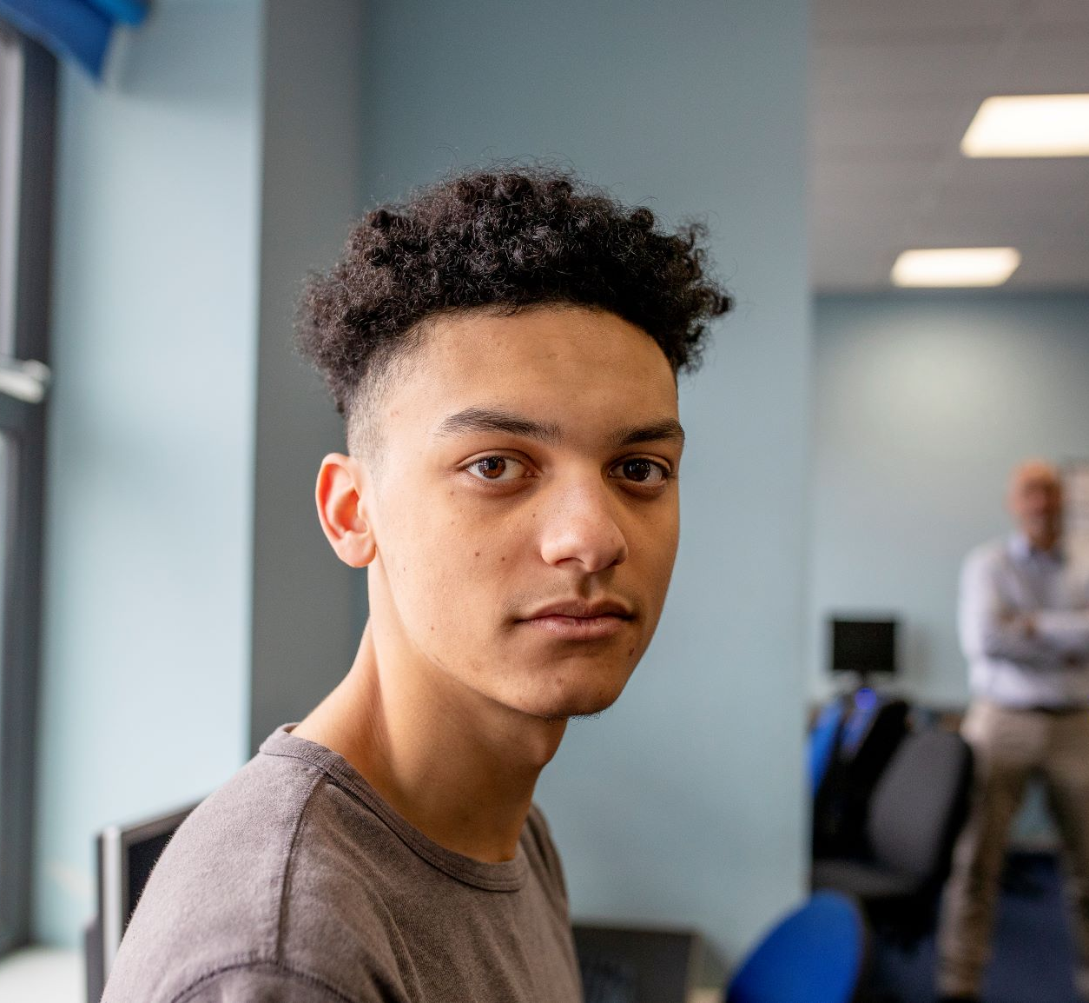
CASE SCENARIO: GIOVANNI, 17 Y/O BOY
Purpose of visit Well visit
Issue that emerges through clinician interview States to clinician that he’s ready to get treatment for a substance use disorder
Parent information Doesn’t want to disappoint parents
Is Giovanni allowed to get outpatient counseling for substance use without a parent’s consent?
Notes:
Let’s take a look at one last scenario. Giovanni is a 17-year-old boy who is struggling with a substance use disorder, but doesn’t want to tell his parents.
Is Giovanni allowed to get outpatient counseling for substance use without a parent’s consent?
[Allow a moment for people to respond either silently to themselves or aloud.]
The answer is yes. Alabama allows minors to seek treatment for substance abuse counseling without parental consent.

Slide 15
Thank you!
Notes:
To keep this conversation going over the next month, I will share Sparklers, or quiz questions, about confidentiality. I’ll post the Sparklers around the office in places that you all can easily see them. When you see a Sparkler, take a moment to read them and reflect on the responses. Thank you for your participation!
[Print and post Sparklers in areas your staff can see (e.g., lunchroom).]

