Slide 1
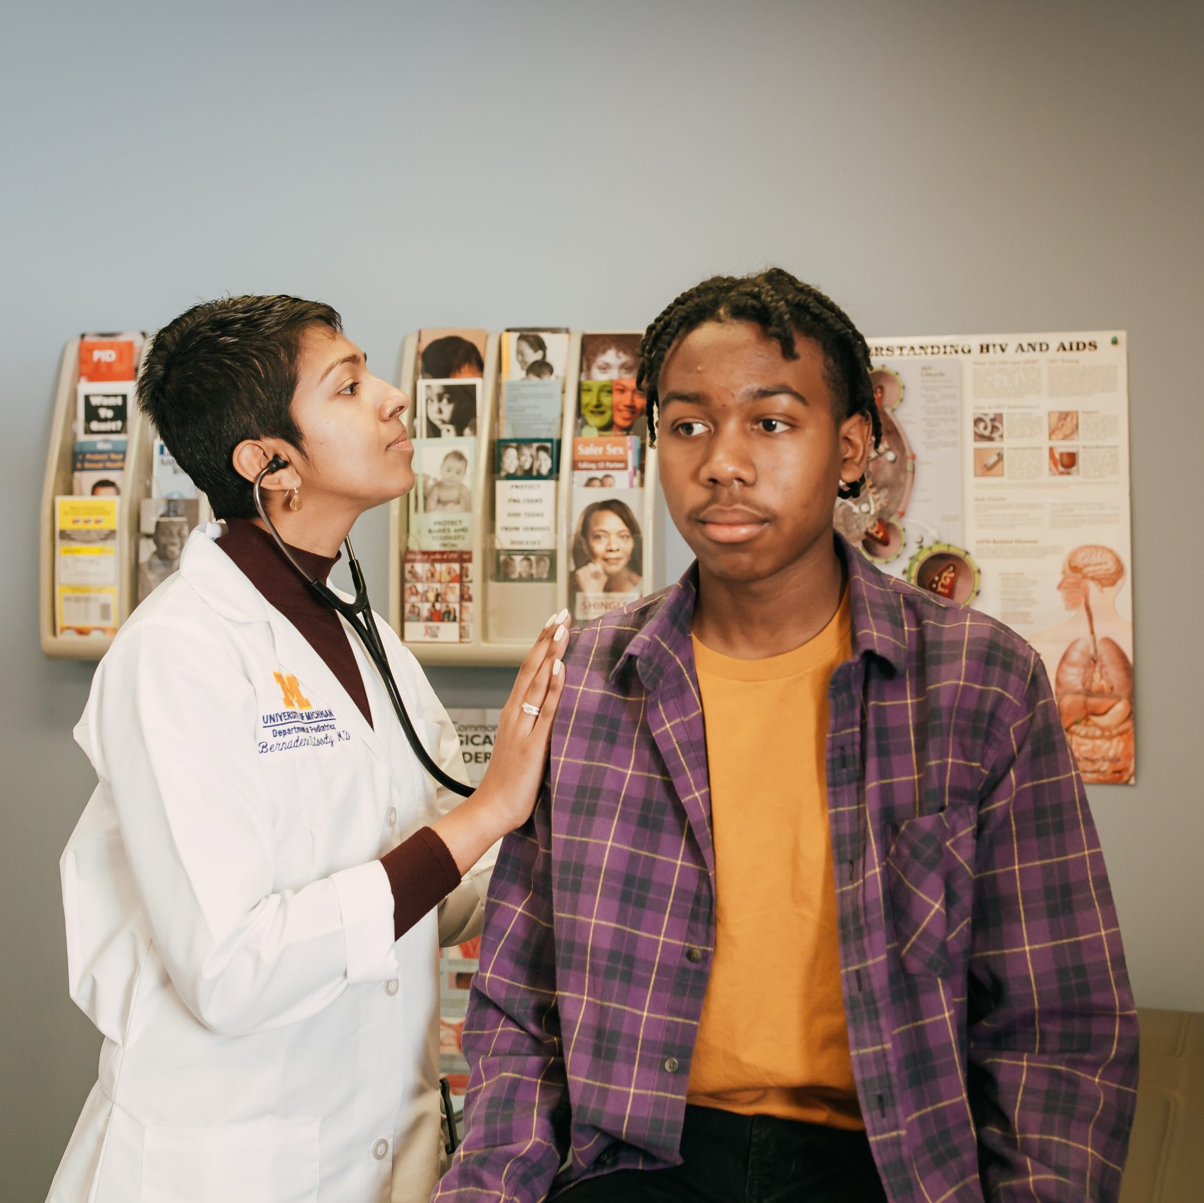
Florida Minor Consent and Confidentiality Laws
For educational purposes only Content updated June 2023
Notes:
Today we are going to do a 15-minute mini-training, also called a Spark. As youth-serving professionals, it is important that we understand adolescent confidentiality and minor consent. This training is intended to be an overview of the most relevant laws on confidential services for teens.
Each person here will have times where we need to know and comply with consent and confidentiality laws, though it’s different for our various roles. For each law and scenario we discuss, try to think about how it applies to your role. To get us started, let’s review a case scenario.

Slide 2
CASE SCENARIO: SHAY, 15 Y/O (they/them)
Purpose of visit Sore throat
Issue that emerges from clinician interview Concerned about having an STI
Parent information Shay says they are worried their mother will kick them out of the house if she knows Shay is sexually active
How does the right to confidentiality
help or hurt Shay?
Notes:
This is Shay, who is 15. They are here today because of a sore throat. During their visit the clinician found out that they are concerned about having an STI. Shay says they are worried their mother will kick them out of the house if she knows Shay is sexually active. How does the right to confidentiality help or hurt Shay?
[Give participants a moment to respond to the question on the slide. You may choose to have discussion here or just have people think about it.]
Usually, not all of this patient information is available to everyone who comes into contact with them. When we know more details about a patient, does it affect how we feel about the patient’s right to confidentiality? Even though we know the law says we need to provide certain confidential services to teens without a parent/legal guardian’s permission, it can be challenging when we think caregivers should be involved. What can go wrong if we accidentally break confidentiality?
[Have a couple of people respond briefly. Main point: If we don’t follow the laws, it can have a negative impact on teens.]
Many teens choose to include their caregiver in decisions about their health. For some teens, however, having the option of certain confidential services makes it more likely that they will seek care when they need it. For instance, Shay would probably be more likely to get tested for STIs and possibly get a method of contraception if they are assured their mother’s permission is not required.

Slide 3
Important Definitions
Consent
Permission to act
Parent/legal guardian must give consent before their minor child can receive services (except specific confidential services)
Confidentiality
How providers and staff keep certain information confidential
Consent ≠ Confidentiality
Notes:
Before we review the laws, it’s important to recognize the difference between consent and confidentiality.
Consent is permission to act. In general, a parent/legal guardian must give their permission – or “consent” – before their minor child can receive a medical service. However, there are important exceptions where a minor can consent to their own care, without a parent/legal guardian’s permission. We will discuss these exceptions today.
Confidentiality refers to how health care providers and staff keep certain information private.
Consent does not equal confidentiality.
o Even if a minor is allowed to consent to a service without a parent/legal guardian’s permission, it does not necessarily mean that the provider is required to keep it confidential.
o So, laws can protect a minor’s right to access a specific service, like contraception, but often, it’s up to health care providers and staff to protect a minor’s confidentiality.

Slide 4
FL Law: caregiver Consent Exceptions
A parent or legal guardian must provide consent on behalf of a minor (under age 18) before health care services are provided, with several important exceptions.
The exceptions are based on either:
The minor’s status (independence from parents/legal guardians), or
The type of service requested (such as certain sexual health services).
Notes:
As this slide says, a parent or legal guardian must provide consent on behalf of a minor (under age 18) before health care services are provided, with several important exceptions.
The exceptions are based on either:
Status (for example, legal independence from parents/guardians), or
The type of service requested (such as certain sexual health services).
[Pass out the “Florida Minor Consent & Confidentiality Laws” handout.]

Slide 5
FL Law: Minor Consent based on status
A MINOR MAY CONSENT TO HEALTH CARE SERVICES WITHOUT A PARENT/LEGAL GUARDIAN’S PERMISSION IF THEY ARE:
A minor who is legally married may consent to health care services
A minor who is prosecuted as an adult in the justice system & confined to a correctional institution may consent to their own care (except for abortion/sterilization procedures)
A pregnant minor may consent to medical and surgical care related to the pregnancy
Managing his/her own financial affairs
Notes:
Here’s a handout that explains Florida’s minor consent and confidentiality laws. As we see in the top section, Florida law allows certain minors to consent to services based on their status. This includes:
A minor may consent to health care services without a parent/legal guardian’s permission if they are:
o 16 years of age or older and
o living apart from their caregivers and
o managing their own financial affairs.
o However, the minor would need to demonstrate legal emancipation by court document using each of these factors as support.
They can also consent to any services if they’re legally married.
A minor who is prosecuted as an adult in the justice system and is confined to a correctional institution may consent to their own care, except for abortion and/or sterilization procedures.
You’ll notice that a pregnant minor may consent to medical and surgical care related to the pregnancy (excluding abortion). Note that the law does not define care which is “related to the pregnancy”.
Are there any questions about the status of minors who can consent to services without a parent or legal guardian’s permission?

Slide 6
FL Law: Minor Consent based on service
MINORS MAY RECEIVE THE FOLLOWING CARE WITHOUT PARENT OR LEGAL GUARDIAN CONSENT:
Pregnancy testing, birth control information and contraceptives if:
Minor is married, pregnant, or a parent
OR Physician determines probable health hazards if services are not provided
Medical and surgical care related to pregnancy
Emergency Contraception
Testing and treatment of sexually transmitted infections (STIs), including HIV
Notes:
[Note: statements are animated to appear one after each click, with the answer showing after the last click. Read each statement aloud before advancing to the next one.]
Now let’s look at the services any minors can receive without parent or legal guardian consent.
[Advance slide]
1.Pregnancy testing, birth control information and contraceptives if one of the following conditions are met:
a) if they are married, pregnant, or a parent OR
b) if a physician determines probable health hazards if services are not provided. There is no further description of “health hazard” defined by the state law, so it is up to the provider’s discretion.
Of course, if the clinic is a Title 10 clinic, then Title 10 rules apply where family planning services can be obtained by a minor (anyone 12 or older) without parental/legal guarian consent.
Having access to contraception is important because there is a growing body of research that shows that sexually active young people are more likely to use birth control if they are assured that they don’t need to involve a parent/legal guardian.
[Advance slide]
2 . Medical and surgical care related to pregnancy for pregnant minors
[Advance slide]
3. Emergency Contraception-minors of any age can buy EC over the counter
4. Testing and treatment of sexually transmitted infections (STIs), including HIV.
a) Florida law even goes a step further by stating providers should have a system in place so that insurance providers are not billed for STD treatment to avoid the Explanation of Benefits (EOB) from being sent to the insurance holder, which is usually the parent(s)/legal guardian(s).
b) Florida law does not expressly allow minors to consent to HIV pre-exposure prophylaxis (PrEP) without parental/guardian involvement. It is considered best practice as part of routine STI prevention to counsel clients on PrEP use when indicated or requested. However, we recommend that you confer with your legal and/or risk management team, and state public health officials, to develop institutional policies around providing PrEP without parental/guardian consent. You can contact the HIV/AIDS Section of the Florida Department of Health at DiseaseControl@flhealth.gov.
[Advance slide]

Slide 7
FL Law: Minor Consent based on service
continued
Substance use treatment, including alcohol or drugs
Outpatient mental health services (age 13 and above)
Mental health treatment may not exceed 2 visits during a 1-week period
Does not include mental health medications and some types of therapy
Notes:
5. Substance use disorder treatment, including for alcohol or drug abuse.
The law also prohibits the release of information about such treatment without the minor’s consent.
[Advance slide]
6. Patients age 13 and up can access outpatient mental health services without parent/legal guardian consent
Mental health services are defined as mental health diagnostic and evaluative services or individual psychotherapy, group therapy, counseling or other forms of verbal counseling from a licensed mental health professional.
There are some restrictions such as:
a) Mental health treatment shall not exceed 2 visits during a 1 week period without parental consent.
b) Mental health medications, somatic methods, aversive stimuli, or substantial deprivation are not included and minors must have parental/legal guardian consent
There is also a clause where mental health professionals can include caregiver participation when deemed appropriate/necessary.
It’s important to keep in mind that if a minor needs a medication for a mental health condition or inpatient mental health services, they would still need their parent/legal guardian’s consent.
Are there any questions about what services minors can access without parent/legal guardian’s permission?
We also have three legislative updates for you: [Advance slide]

Slide 8
legislation Update
AS OF JULY 1, 2020:
Abortion:
For minors requesting an abortion, provider must obtain written parental/legal guardian consent.
Prior to this law, providers were mandated to provide a 48-hour notice to parents/legal guardians, prior to performing the abortion.
Notes:
Senate Bill 404 was signed into legislation by the governor on July 1, 2020. For minors requesting an abortion, provider must obtain written parental/legal guardian consent.
Prior to this law, providers were mandated to provide a 48-hour notice to parents/legal guardians, prior to performing the abortion.
This new requirement does not apply in cases of medical emergency, and the minor may petition the circuit court for permission.

Slide 9
New legislation Update
AS OF JULY 1, 2020:
Pelvic Examinations:
A provider must obtain written consent from the patient or their parent/legal guardian to perform any pelvic examination unless:
By court orders the performance of an examination OR
Is immediately necessary to avoid serious risk
Notes:
Florida Senate Bill 698 was signed into law on July 1st, 2020 by the governor which requires written consent from the patient or their parent/legal guardian to perform any pelvic examination, unless:
By court orders the performance of an examination OR
Is immediately necessary to avoid serious risk
While this is currently the way the law is written, there has been criticism of using broad language which has left many health care providers scrambling to interpret the law and put it into action in practice. At this point, the law remains unchanged.
Note that services that minors can consent to (e.g. STD testing/treatment), they can also consent for a pelvic examination themselves.

Slide 10
legislation Update: Parent bill of rights
AS OF JULY 2021:
A health care provider must now obtain a parent/legal guardian’s written consent before providing services, prescribing medicine, or performing a medical procedure, UNLESS “otherwise provided by law.” *
Under this new law, in health care, parent/legal guardian rights include:
The right to make health care decisions, unless otherwise prohibited by law*
The right to access and review medical records related to the child
*The FMA General Counsel’s Office maintains that “except as otherwise provided by law” exempts from the parent/legal guardian consent requirement for only those statutes that specifically allow a physician to provide or a minor to receive health care services without parent/legal guardian consent.
Notes:
Florida House Bill 241 was signed into law on July 1st, 2021 by the governor which requires health care providers to obtain a parent/legal guardian’s written permission before providing services, prescribing medicine, or performing a medical procedure, UNLESS “otherwise provided by law.” *
Under this new law, in health care, parent/legal guardian rights include:
The right to make health care decisions, unless otherwise prohibited by law
The right to access and review medical records related to the child
*The FMA General Counsel’s Office maintains that “except as otherwise provided by law” exempts from the parent/legal guardian consent requirement only those statutes that specifically allow a physician to provide or a minor to receive health care services without parent/legal guardian consent.
This means that all of the services minors are able to access without parent/legal guardian consent (as we discussed on the previous slides), are not impacted by this bill.
There are some nuances here where minors can consent to certain components of treatment and this would be confidential (specifically mental health), but other areas of the record would not be. For example, confidential mental health statements would remain confidential, whereas records of prescription medication for mental health conditions could be accessed by a parent/legal guardian and they could or could not consent to the medication.
For more information on the Parent Bill of Rights:
https://miamimed.com/news/572974/Treating-minors-under-Floridas-new-parental-consent-law.htm
https://www.myfloridahouse.gov/Sections/Bills/billsdetail.aspx?BillId=70313

Slide 11
Hpv vaccines & mental health meds
Notes:
Can a minor in the state of Florida give consent for the HPV vaccine?
The answer in Florida is no. A minor cannot consent for the HPV vaccine. To get any vaccine, a parent/legal guardian must sign that they received a vaccine information statement (VIS).
On your handout, you’ll see this toward the bottom. Note that mental health medications also require a caregiver’s consent.

Slide 12
Reporting
Providers must override a minor’s confidentiality and report if:
If the minor poses a danger to self or others
There is suspicion of abuse or neglect
Sexual activity occurred that was without consent, without equality, or as a result of coercion
The minor is under age 16 and has been sexually active with an adult over age 24
Notes:
Now we’re going to review when a minor’s confidentiality must be overridden. Health care providers must override the minor’s confidentiality and report…
If the minor poses a danger to self or others
There is suspicion of abuse or neglect
Sexual activity occurred that was without consent, without equality, or as a result of coercion
The minor is under age 16 and has been sexually active with an adult over age 24
Again, this part of the law allows a provider to tell a parent/legal guardian about these specific confidential services if it’s in the best interest of the young person

Slide 13
CASE SCENARIO: SHAY, 15 Y/O (they/them)
Purpose of visit Sore throat
Issue that emerges from clinician interview Concerned about having an STI
Parent information Shay says they are worried their mother will kick them out of the house if she knows Shay is sexually active
Can Shay receive STI testing without their parent/legal guardian’s permission?
Can Shay receive STI treatment without their parent/legal guardian’s permission?
Can Shay receive contraception without their parent/legal guardian’s permission?
Notes:
Let’s go back to our 15-year-old patient, Shay , and answer these questions together as I read through them.
Can Shay receive STI testing without their parent/legal guardian’s permission? [Answer: Yes, they can]
Can Shay receive STI treatment without parent/legal guardian’s permission? [Answer: Yes, Florida law allows minors to receive STI testing and treatment.]
Can Shay receive contraception without their parent/legal guardian’s permission: [Answer: Maybe, according to the law, minors who are only married, pregnant, or a parent can consent to contraception UNLESS the provider believes that not prescribing contraception will impose an “immediate health hazard” to the patient. Therefore, it is up to individual provider’s discretion to make that decision.]

Slide 14
CASE SCENARIO: SHAY, 15 Y/O (they/them)
Information regarding consultation, examination, or treatment for a STI provided to a minor may NOT be disclosed to a parent without the teen’s consent.
If Shay’s mother calls the clinic to ask if Shay received an STI test, can this information be released?
Are there other ways that Shay’s mother could find out that Shay received this service?
Notes:
If Shay’s mother calls the clinic to ask if Shay received an STI test, can this information be released? [Answer: No. There is special protection for this under Florida law that prohibits direct or indirect disclosure of STI consultation, examination, and treatment]
Are there other ways that Shay’s mother could find out that Shay received this service?
[Answer: No, she shouldn’t—the law states that STD testing/treatment should not be divulged in any direct or indirect manner, including billing statements. If they use their caregiver’s health insurance, an explanation of benefits (EOB) form is typically sent for each visit including medical services rendered. Florida law does prohibit STD testing/treatment from being included on EOBs unless permission is explicitly given by the patient. However, with office copays and/or paying out of pocket, breaches in confidentiality are possible.
For maximum confidentiality, a minor may go to a provider that is able to provide services without billing insurance, like a Title Ten clinic. The Spark on Confidentiality Best Practices covers more strategies to ensure confidential services for minors.

Slide 15
CASE SCENARIO: GIOVANNI, 17 Y/O (He/him)
Purpose of visit Well visit
Issue that emerges through clinician interview States to clinician that he’s ready to get treatment for a substance use disorder
Parent information Doesn’t want to disappoint family
Is Giovanni allowed to get outpatient counseling for substance use without a parent/legal guardian’s consent?
Notes:
Let’s take a look at one last scenario. Giovanni is a 17-year-old who is struggling with a substance use disorder but doesn’t want to tell his family.
Is Giovanni allowed to get outpatient counseling for substance use without a parent/legal guardian’s consent?
[Allow a moment for people to respond either silently to themselves or aloud.]
The answer is yes. Florida allows for minors to seek treatment for substance use counseling without caregiver consent.
Additionally, the law states that to disclose any information to parent/legal guardians, written permission must be obtained by the minor.

Slide 16
Thank you!
For educational purposes only.
Notes:
To keep this conversation going over the next month, I will share Sparklers, or quiz questions, about confidentiality. I’ll post the Sparklers around the office in places that you all can easily see them. When you see a Sparkler, take a moment to read them and reflect on the responses. Thank you for your participation!
[Print and post Sparklers in areas your staff can see (e.g., lunchroom).]

